Slide 1

Devanagari Character Recognition Using CNN
A Deep Learning Approach for Character Recognition
Bsc. CSIT Final Year Project
Group Members :
Anukul Banjade(25510/077)
Koshish Pokharel(25540/077)
Prajjwal Lamsal(25553/077)
Supervisor :
Sunil Luitel

Slide 2
Project Overview
Core Purpose
Main technologies
Develop an recognition system for Devanagari text.
Essential for digital transformation and cultural preservation.
Supports Hindi, Sanskrit, Marathi, and Nepali languages.
Recognition of Devanagari characters.
React, Flask, TensorFlow, Postgres

Slide 3
Problem Statement
Challenge of digitizing Devanagari text
Need for accurate character recognition
Importance in preserving and processing Devanagari documents
Devanagari has intricate characters and ligatures

Slide 4
Key Features
Real-time character recognition
Audio output for recognized characters
User authentication system
History tracking of predictions
Mobile-responsive interface

Slide 5
Methodology
Image Input and Pre-processing:
Image Upload
Gray scale Conversion
Image Resizing
Normalization
Noise Removal

Slide 6
Methodology
CNN Model For Feature Extraction :
Conv2D layers
Relu Activation Function
MaxPooling2D
Flatten Layer
Dense Layer
SoftMax Activation

Slide 7
Methodology
Training :
Pre-processing
Create model
Train model
Test model
Save model

Slide 8
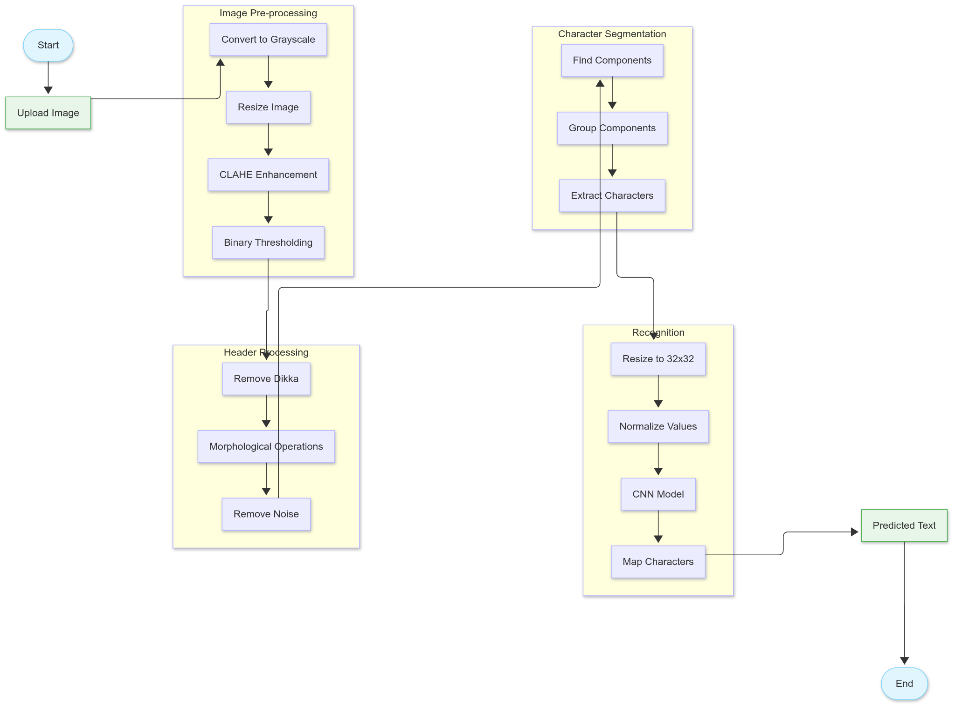
System Architecture

Slide 9
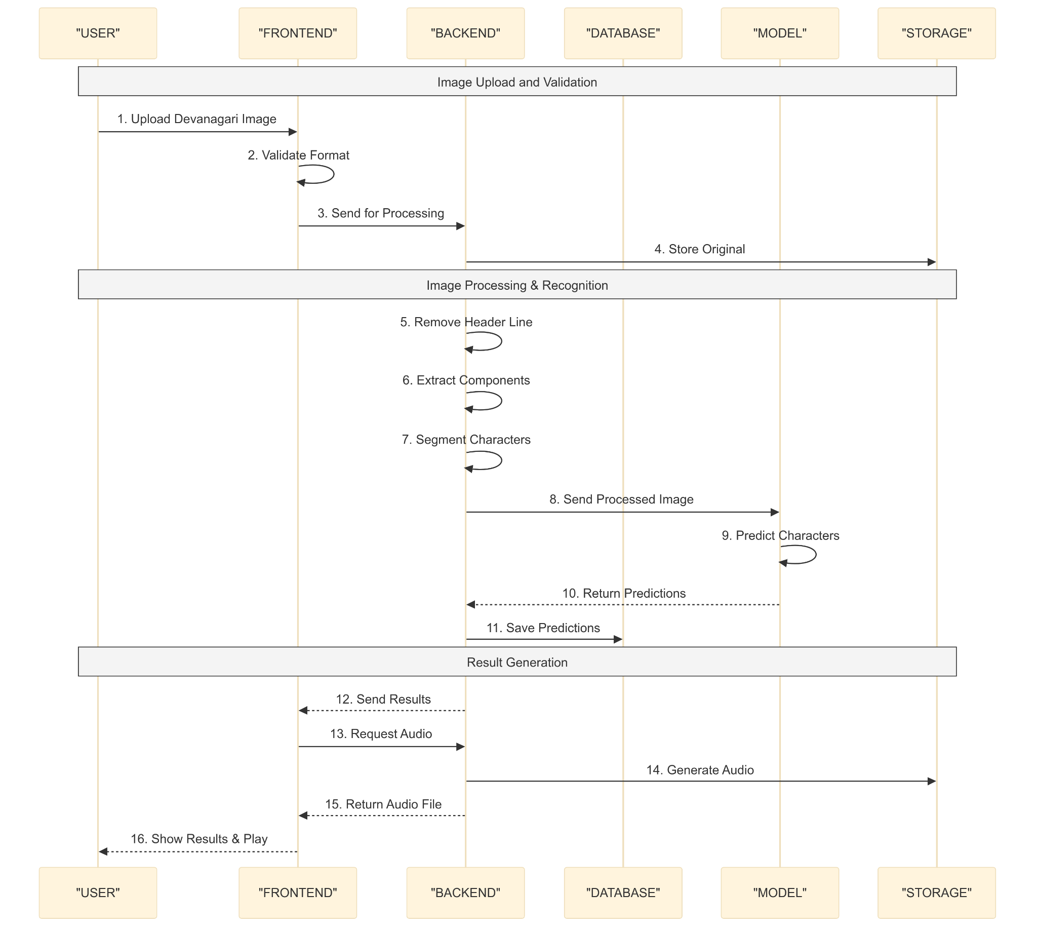
Sequence Flow Diagram

Slide 10
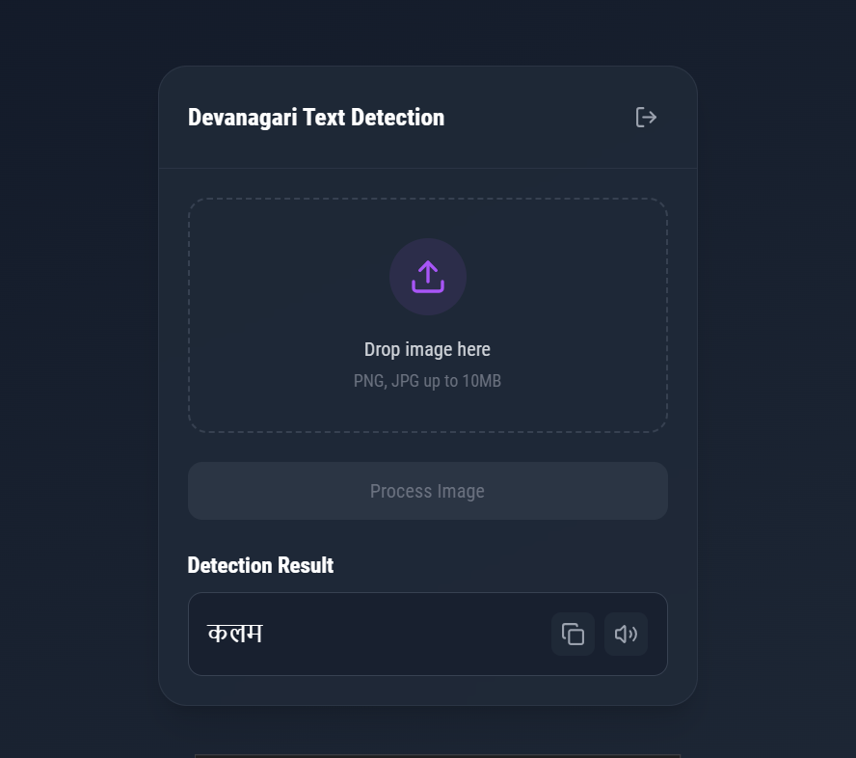
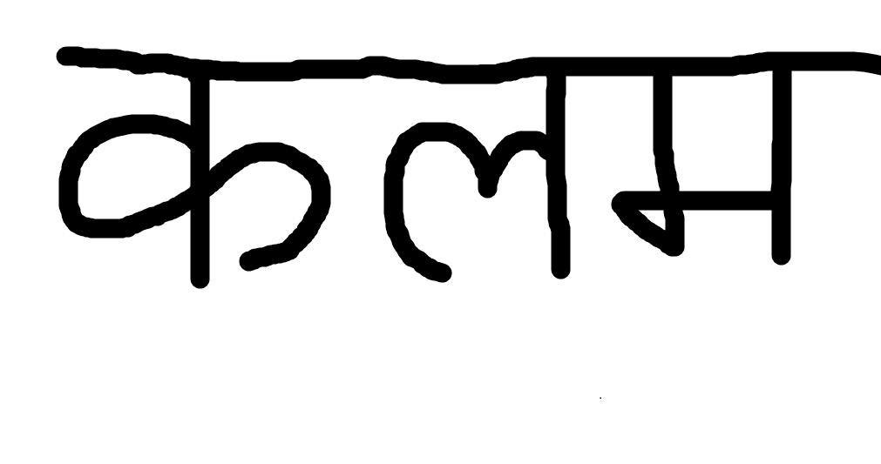
Results & Testing

Slide 11
Future Improvements
Technical:
Enhanced model support for conjunct characters and numbers
Real-time camera input for instant recognition
Mobile application development
PDF document processing capability
Performance:
Offline mode functionality
Improved processing speed and accuracy
Integration with educational platforms

Slide 12
Demo

